Slide 1
Design & Implementation presentation on
Automated Tourist Information Guide

Slide 2
Content
Abstract
Architectural Design
Use-case Diagram
Modular Design Diagram
Data Flow Diagram
Sequence Diagram
Control Flow Diagram
Activity Diagram
Implementation Approaches

Slide 3
Abstract
In this project, we aim to utilize machine learning techniques to suggest tourist destinations to users, using tourist reviews as the basis for recommendations.
For this project, we used a dataset of tourist reviews that includes information about various tourist destinations and the corresponding reviews provided by the tourists.
We aim to train a machine learning model using a dataset, and utilize it to recommend tourist places to users.
Our proposal is a straightforward framework for a tourism recommender system. The aim of this system is to help prospective travelers in finding the most suitable destination that meets their preferences and needs.

Slide 4
Experts feedback
Recommending nearby places with respect to chosen destination.

Slide 5
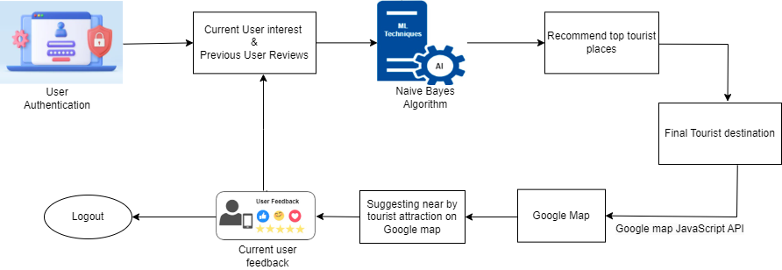
Architectural Diagram

Slide 6
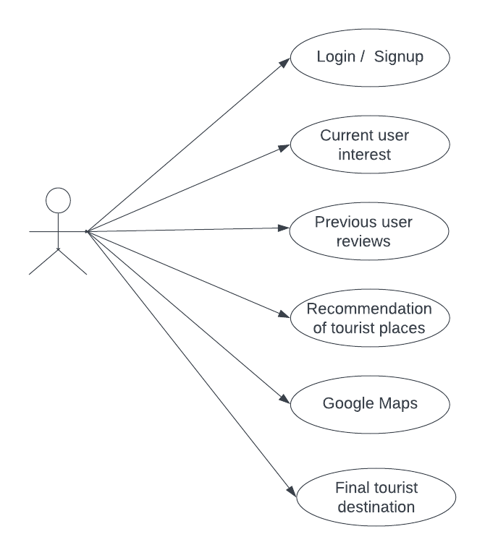
Use-Case Diagram

Slide 7
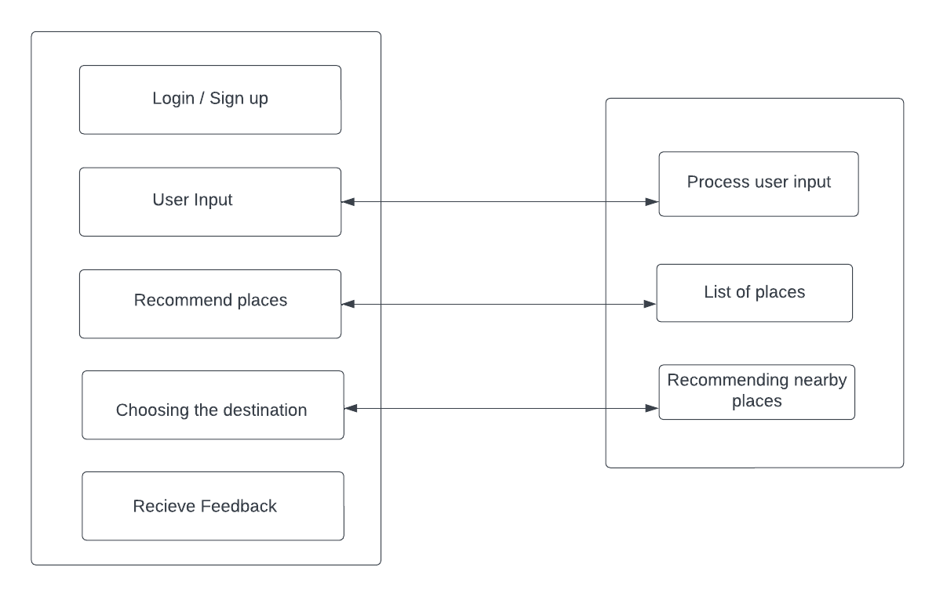
Modular Diagram

Slide 8
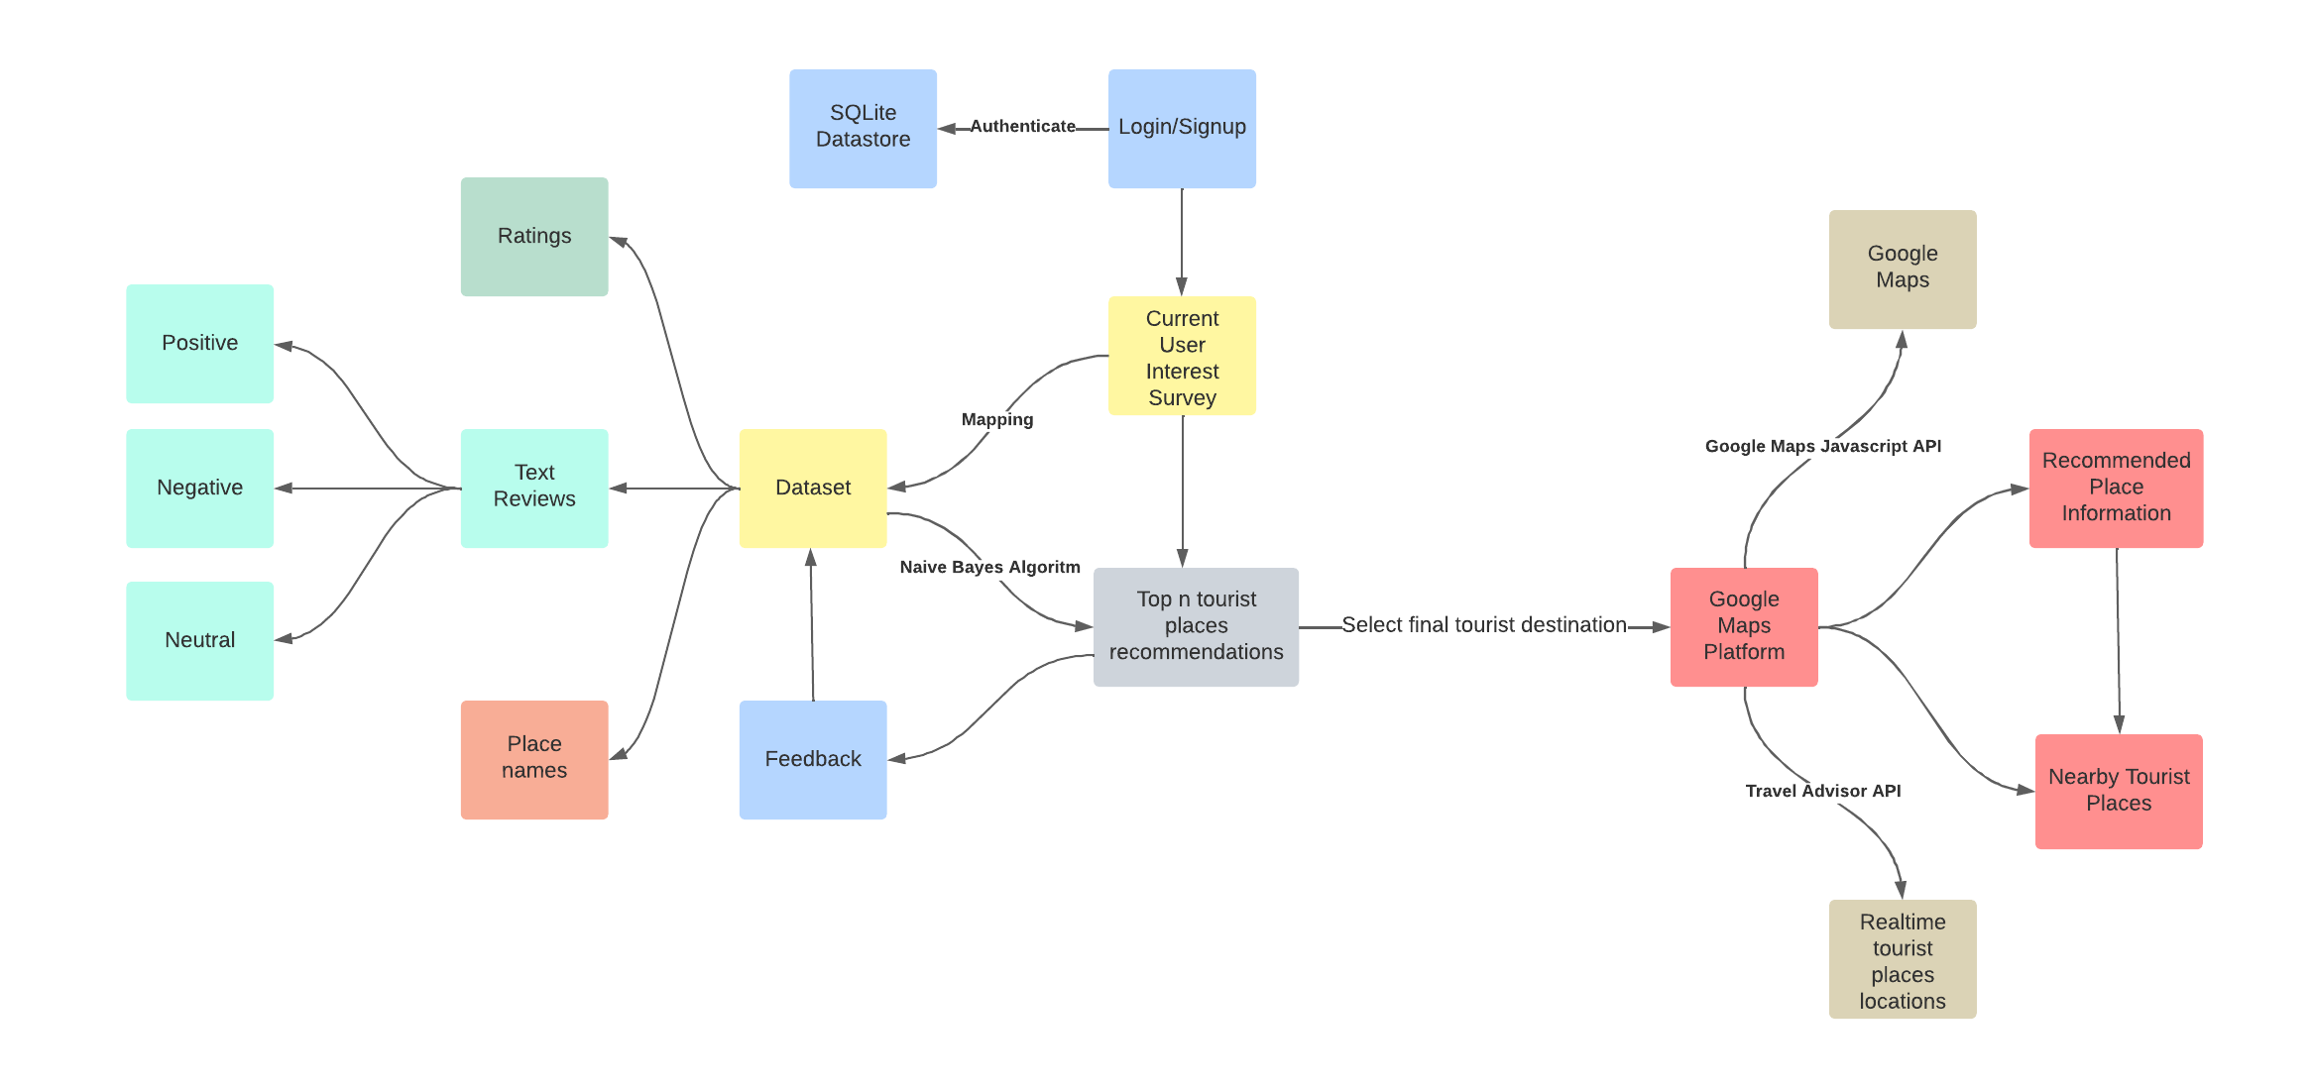
Data Flow Diagram

Slide 9
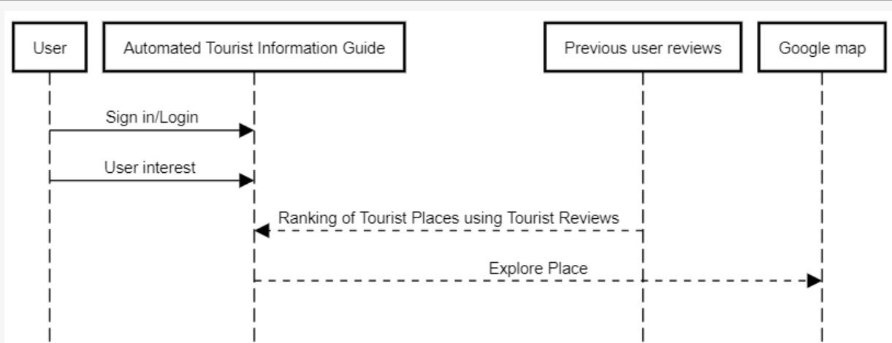
Sequence Diagram

Slide 10
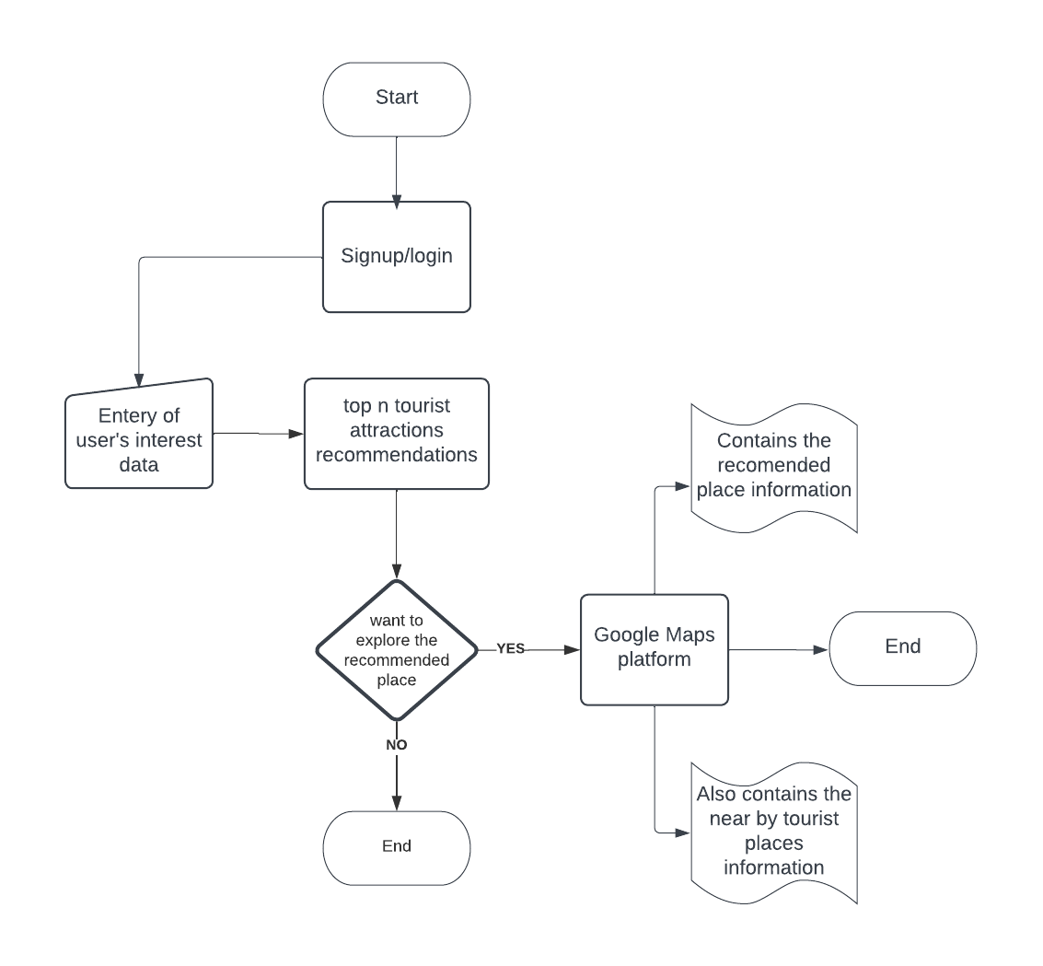
Control Flow Design

Slide 11
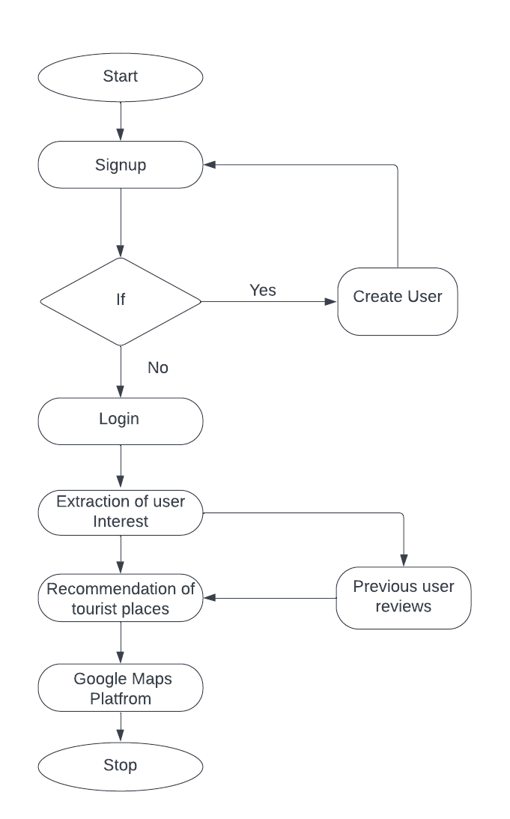
Activity diagram

Slide 12
Implementation Approaches
Clustering Algorithm: Each time a new user joins the system and provides her user preference attributes, a clustering algorithm will be applied. The clustering algorithm will identify groups of similar users. Moreover, the clustering algorithm will be applied whenever the preferences of a user are updated (explicitly or implicitly).
Naive bayes Algorithm: The Naive Bayes model was utilized to determine the probability of the occurrence of each term in positive and negative reviews. As per Baka (2016), tourist destinations can gain a competitive edge by effectively converting dissatisfied customers into happy ones. The accuracy of the Naive Bayes algorithm for TripAdvisor's attraction reviews was evaluated to assess its predictive power. The developed model based on the Naive Bayes algorithm was employed to ascertain that the analyzed terms significantly impact tourist sentiments.

Slide 13
Thank You

